Slide 1
Capacitors and conductors
How electuwuicity moves

Slide 2
Gravity

Slide 3
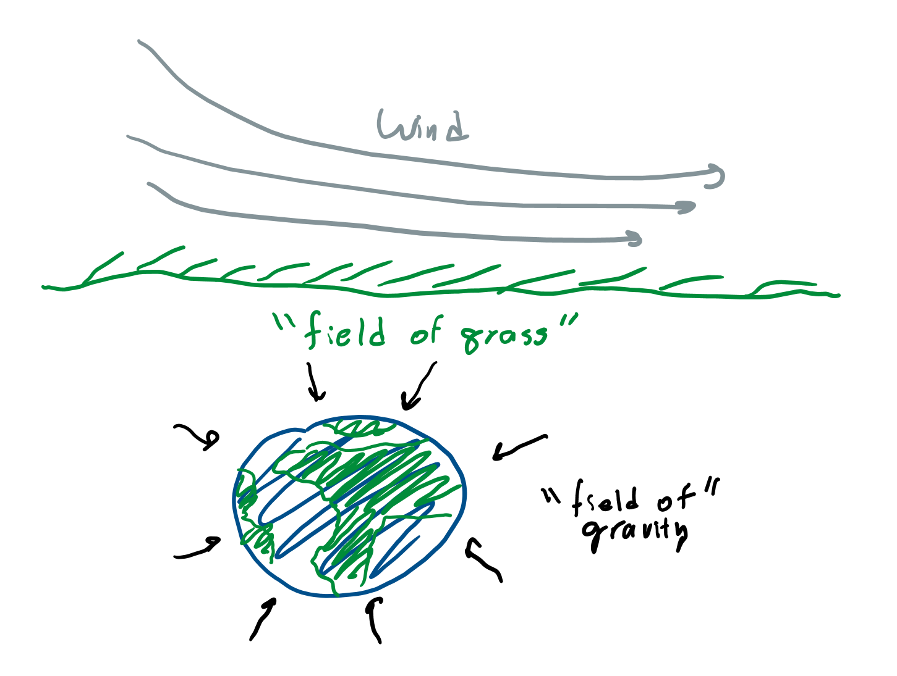
Gravitational field
If I drop a ball which direction will it fall?
Which direction does gravity pull?
Since gravity pulls down, we can draw an arrow downward and call that the direction of the gravitational “field.”

Slide 4
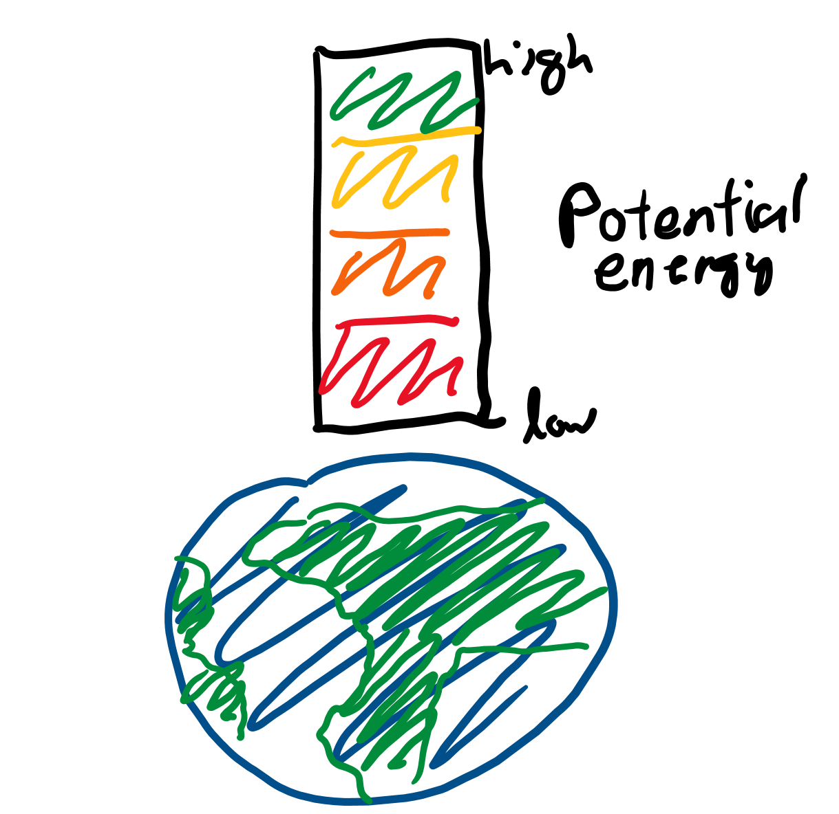
Potential energy
Would you have more “potential” to fall down if you were higher or lower?
How do you think “potential energy” changes as you move upward?

Slide 5
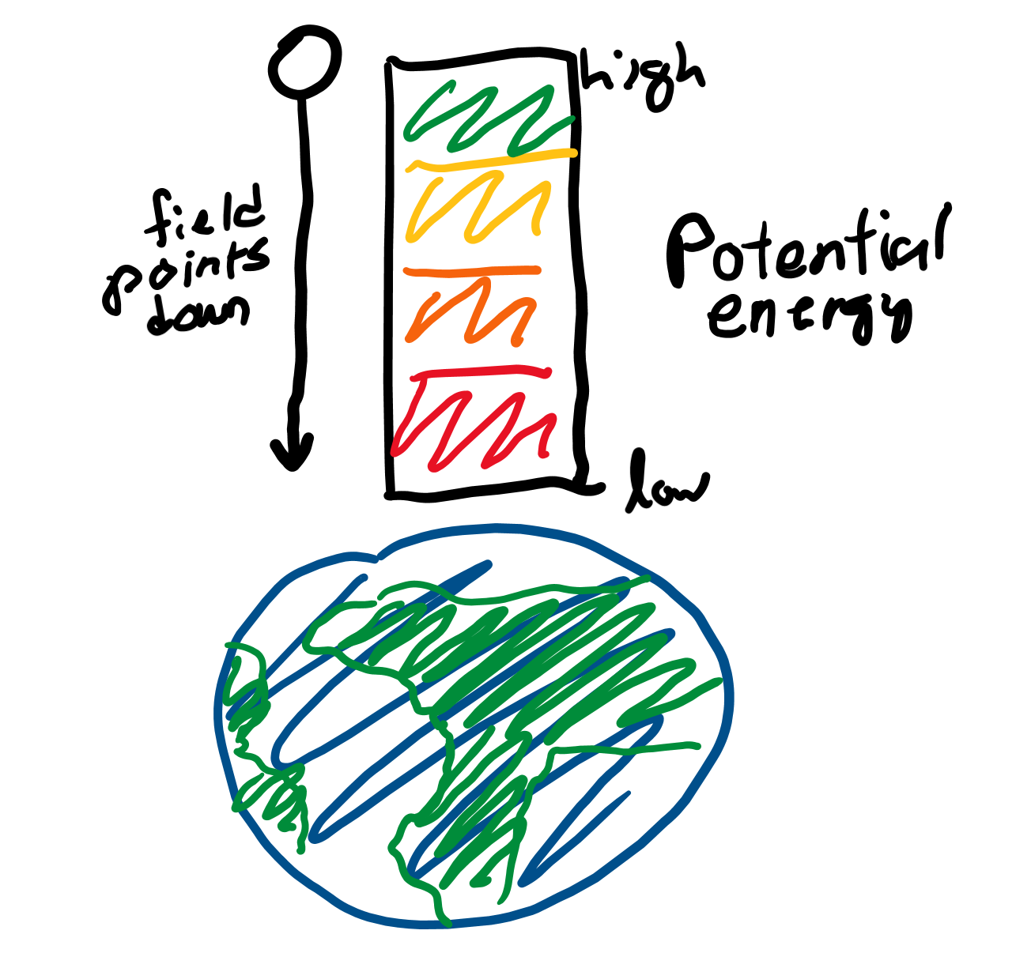
Field-potential relationship
If I place an object at high potential, will it go to a place with high or low potential?
Does the “field” of gravity go from high to low or low to high potential?

Slide 6
Capacitors

Slide 7
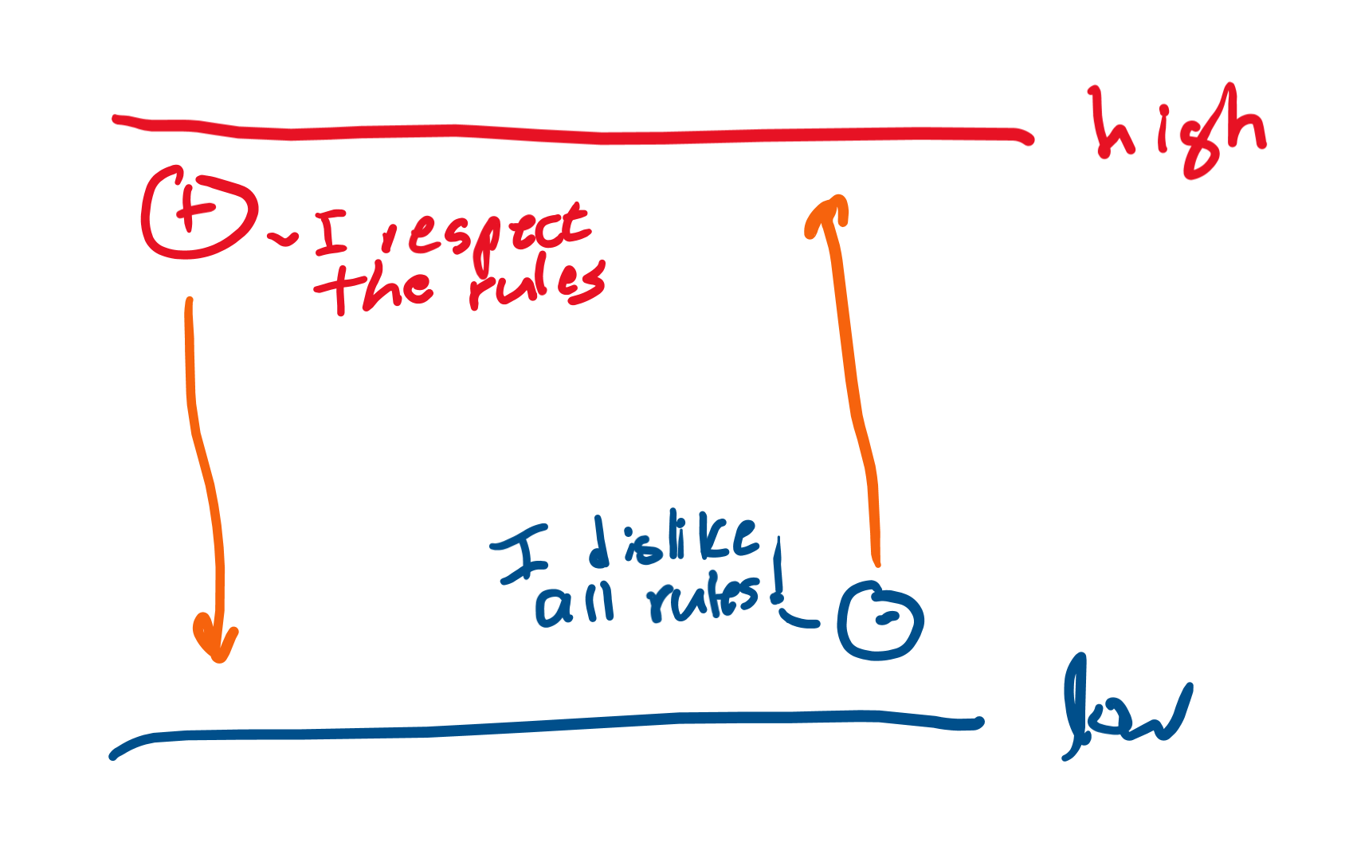
Positively and negatively charged items
“Protons” have positive “charge.” What kind of charge do electrons have?
“Positive” behave just like masses falling due to gravity: they move from high to low potentials.
How would the “negatively”-charged electron behave?

Slide 8
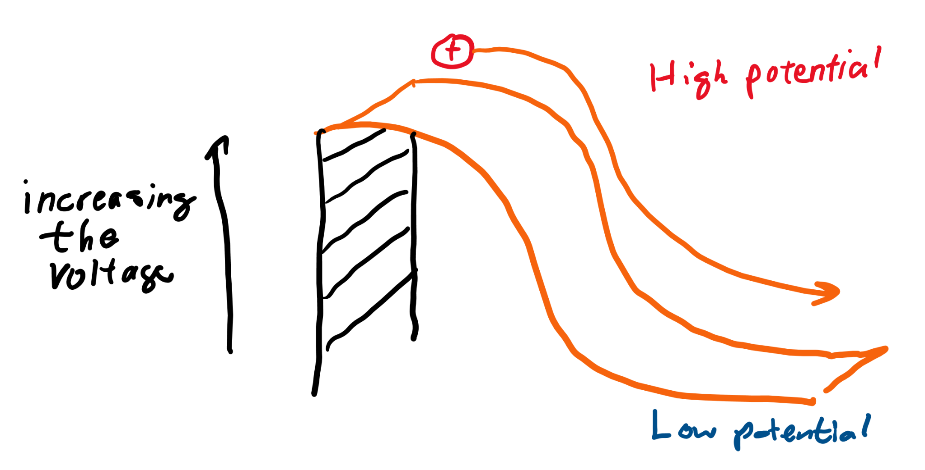
Electric potential and voltage
If you increase potential energy, was the object able to move more or less?
If you increase the electric potential, will a charged particle “move” more or less?
“Voltage” is the difference in the electric potentials.

Slide 9
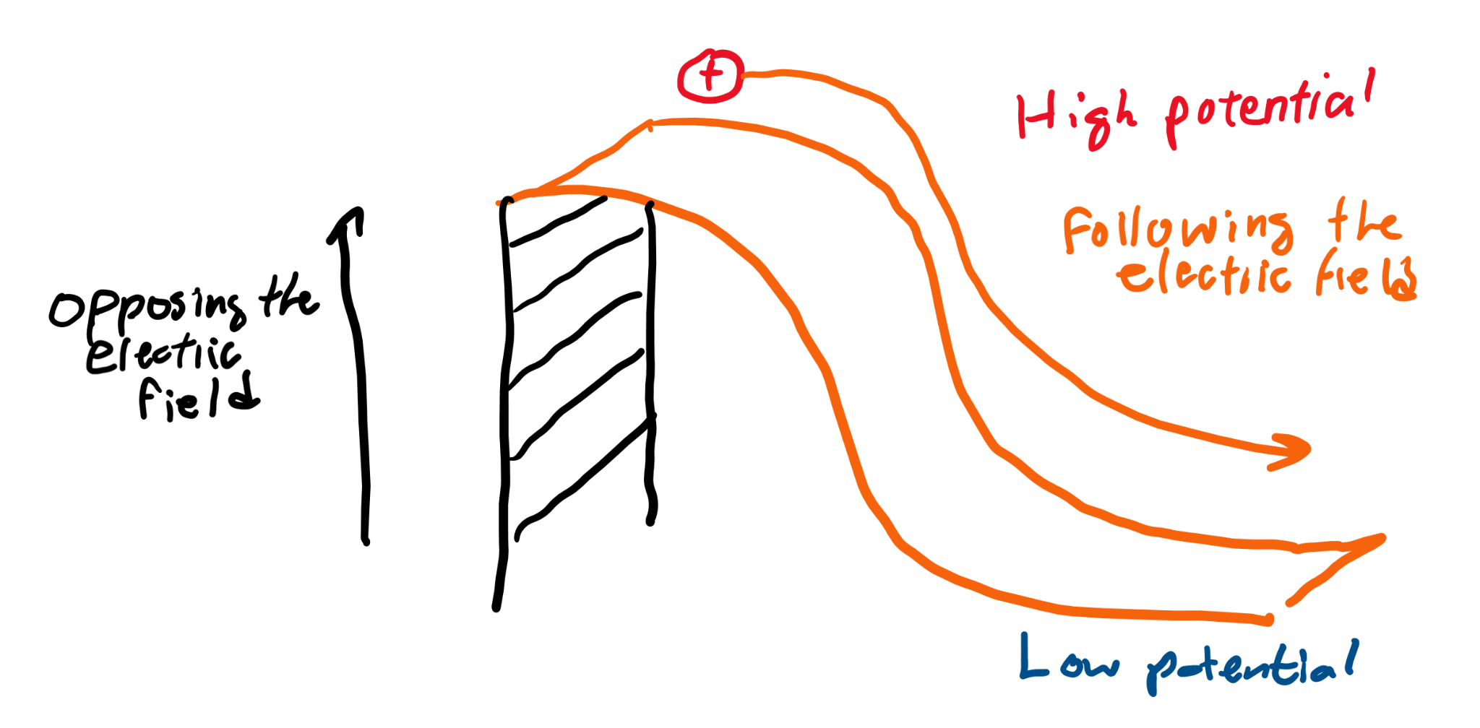
Electric field
Does the electric field point from high to low or low to high potential?
The electric field is the direction a positive charge will move!

Slide 10
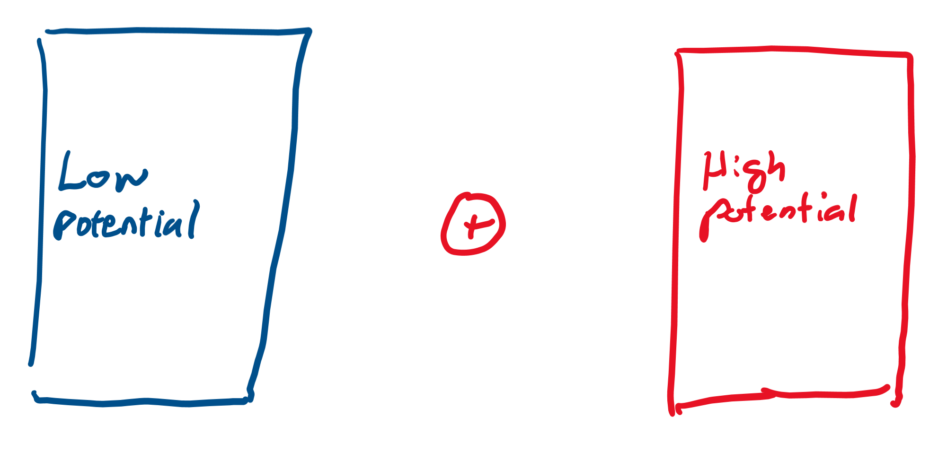
Capacitors
Capacitors have to sides, one with “high potential” and one with “low potential.”
On the image, do you think a positive charge will move from left to right or right to left?
Because capacitors can make charges move, they “store” electrical energy. What other items store electrical energy? (Answer on next slide.)

Slide 11
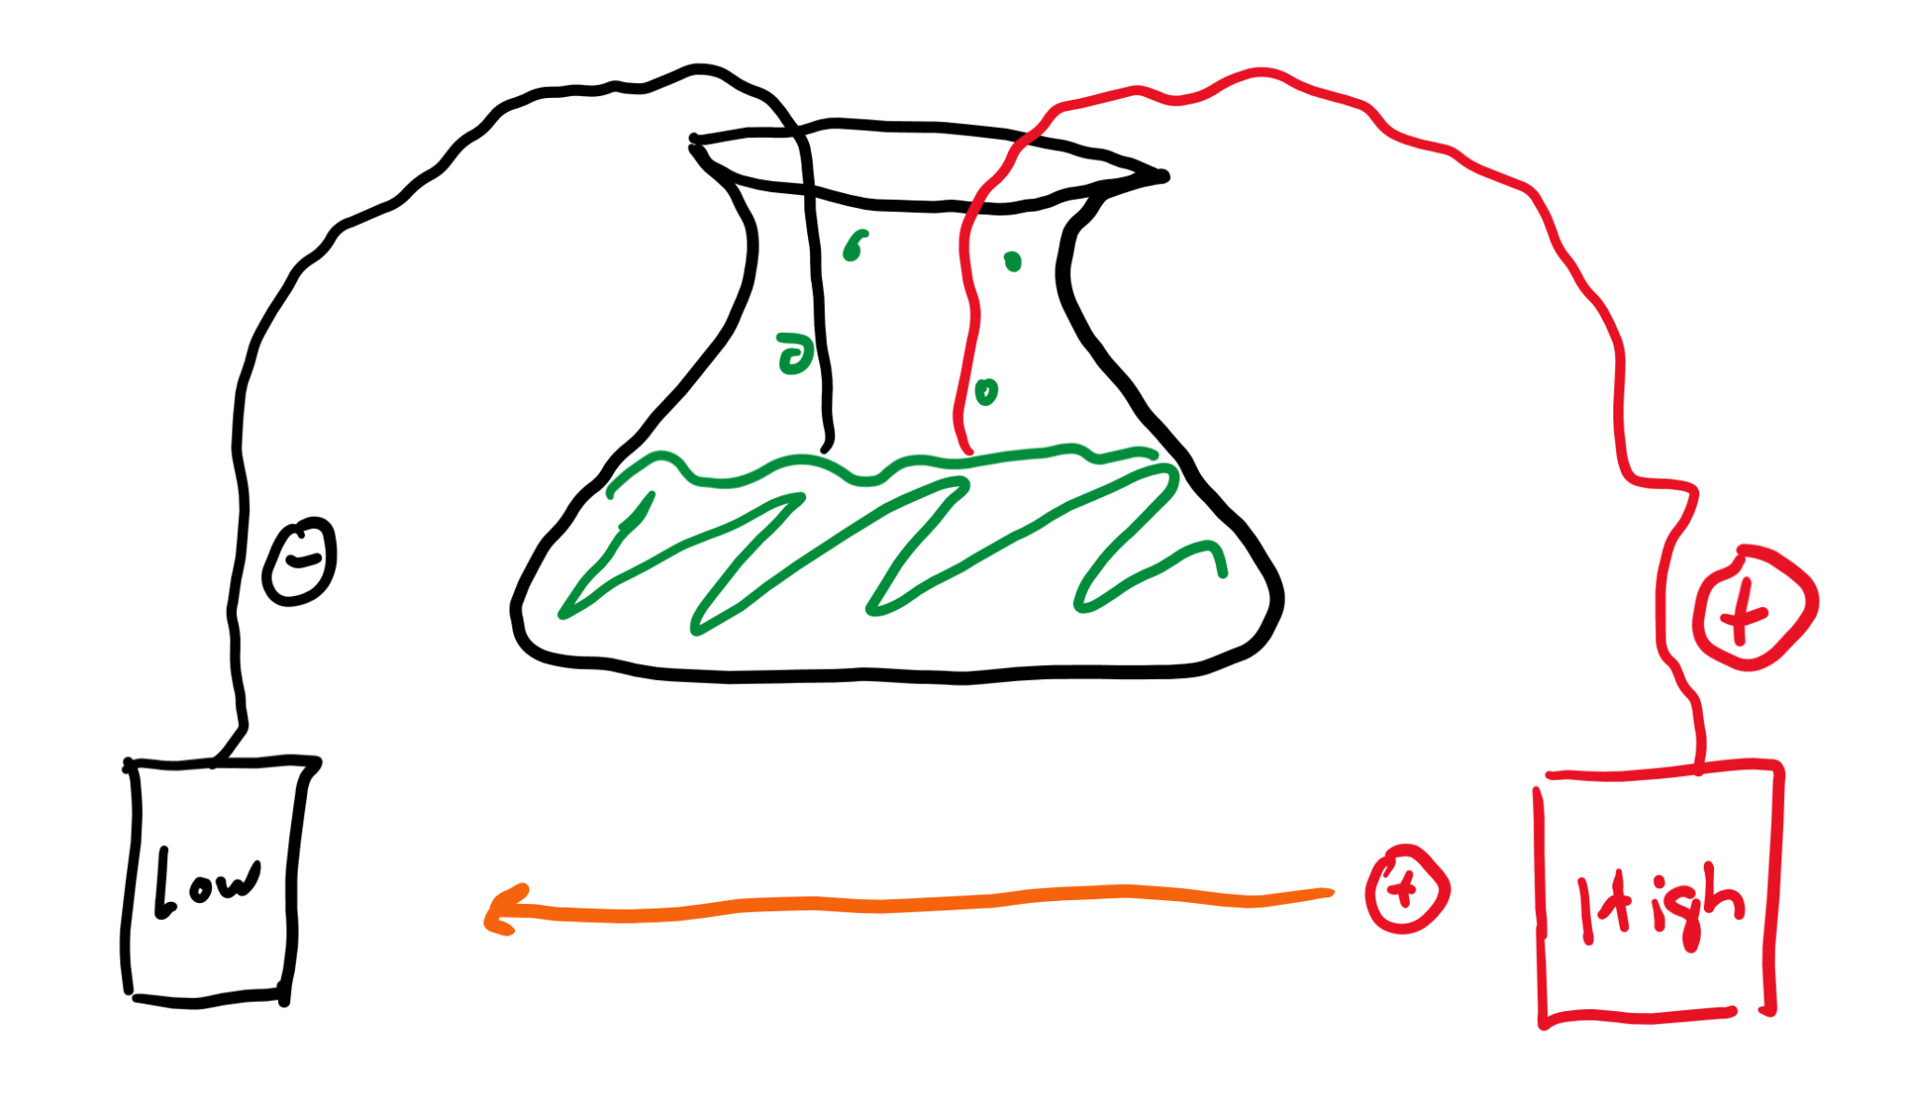
Batteries
Batteries also have “high” and “low” potential areas, but they use chemical reactions to create them.

Slide 12
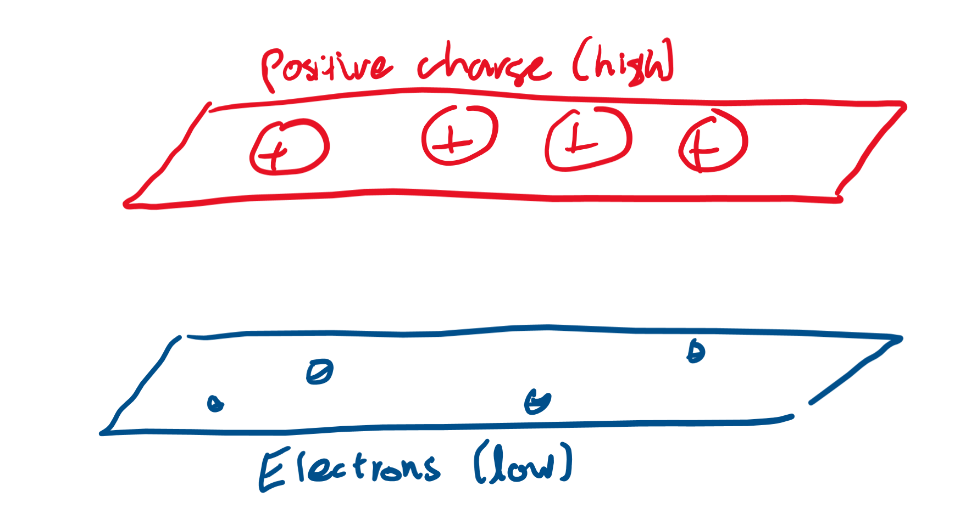
What produces high/low potential?
High potential areas are made of concentrated “protons,” and low potential areas are made of concentrated “electrons.”

Slide 13
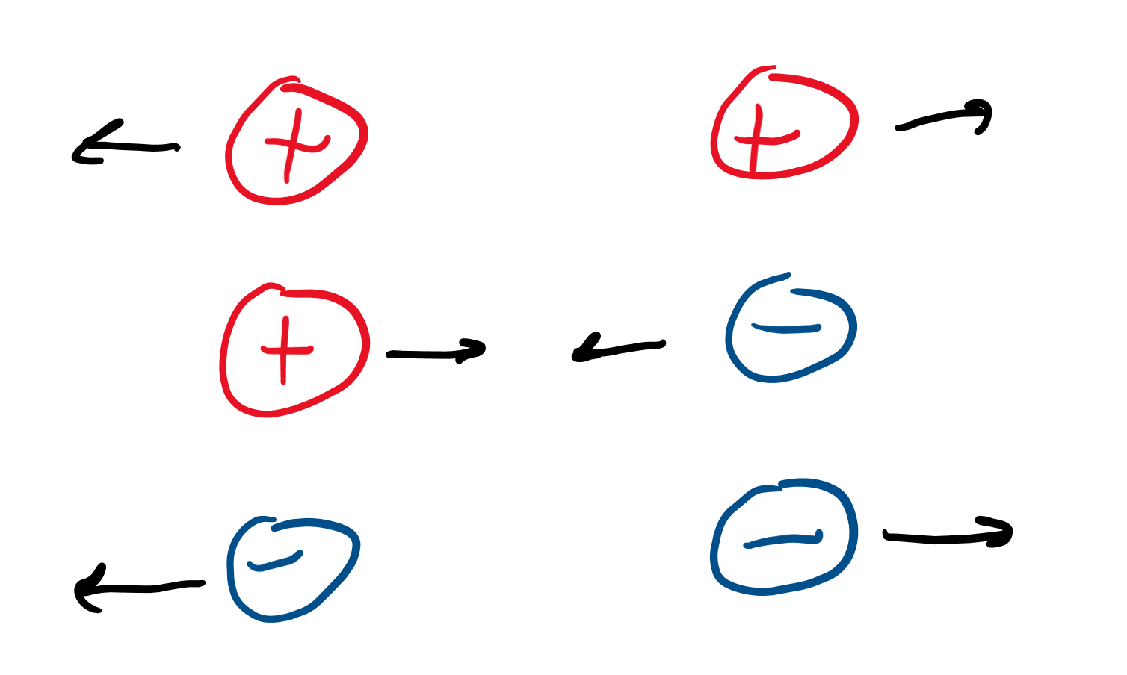
Repulsion theory
Opposites attract, so which pair(s) repel:
Proton + proton
Proton + electron
Electron + electron
If high potential areas have a bunch of protons, why might protons move away from high potential areas?

Slide 14
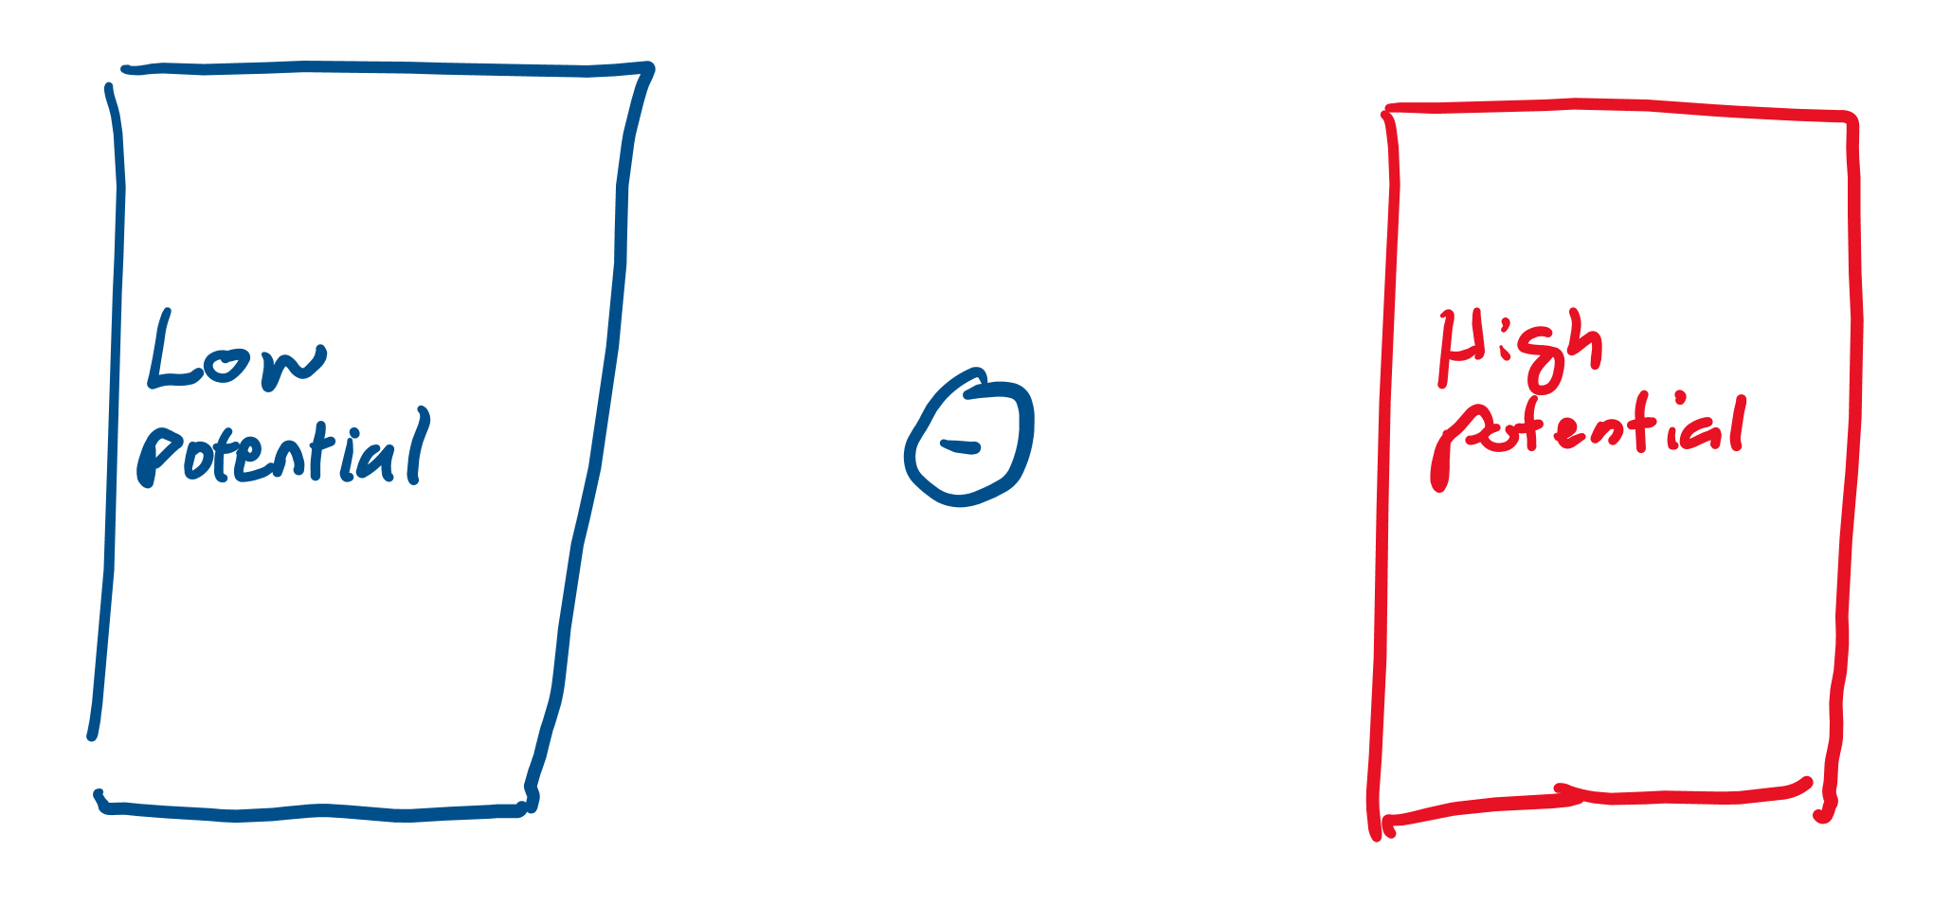
What happens if we have an electron instead?
Which direction will the electron in the picture move? Left to right or right to left?
Why do we care how electrons move? The motion of “electrons” generates “electricity!”

Slide 15
Conductors

Slide 16
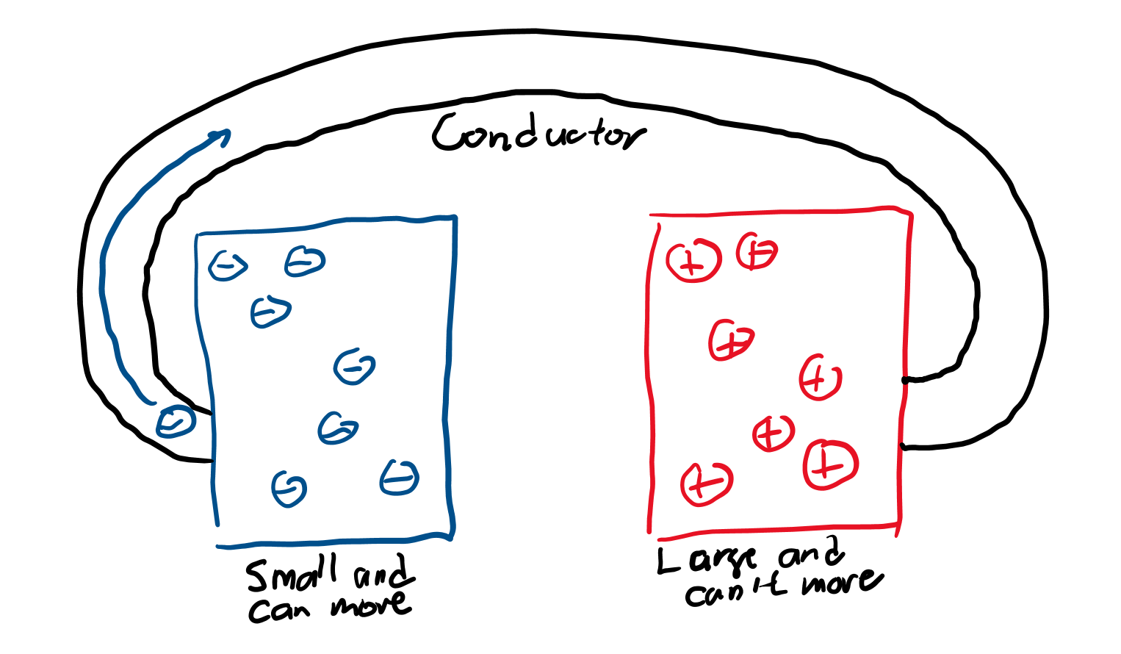
Electricity is “conducted” by conductors haha (laugh)
Electrons move from low potential to high potential areas through “conductors” kind of like water moving through a pipe.
Which way does the electric field point? Along the blue arrow or opposite it? (Remember electric field is the direction a proton would travel.)

Slide 17
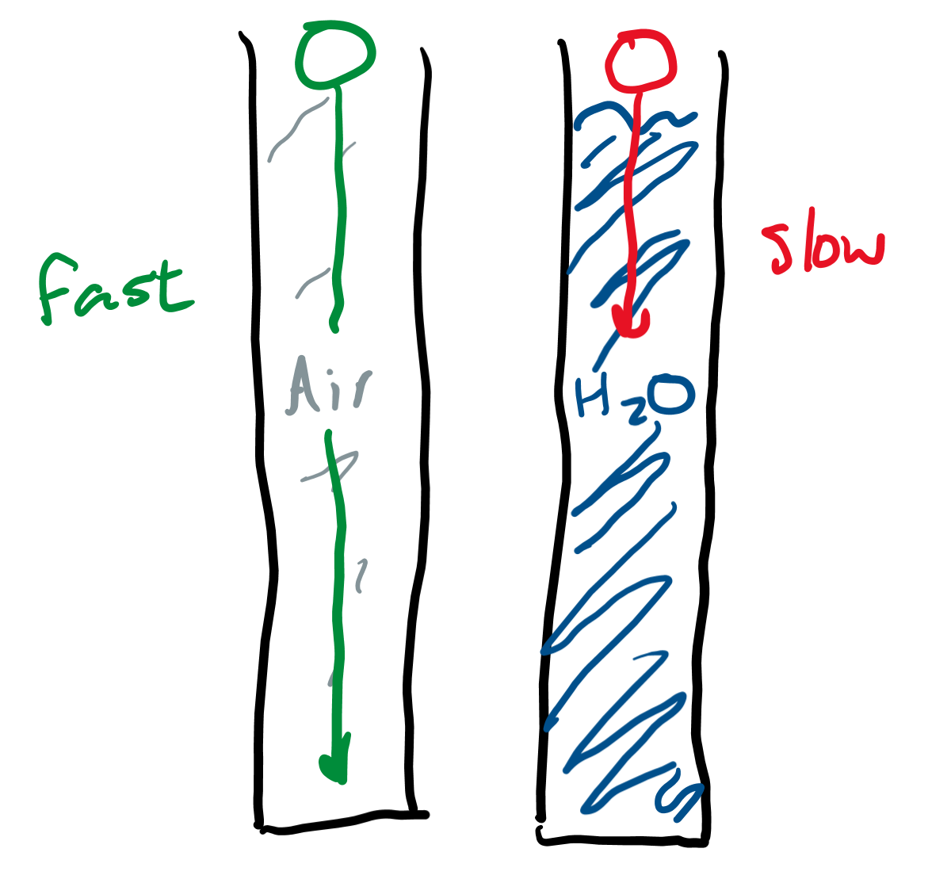
Objects in different mediums
A “medium” is something you can travel through. Would a ball fall faster through a medium filled with air or a medium filled with water?

Slide 18
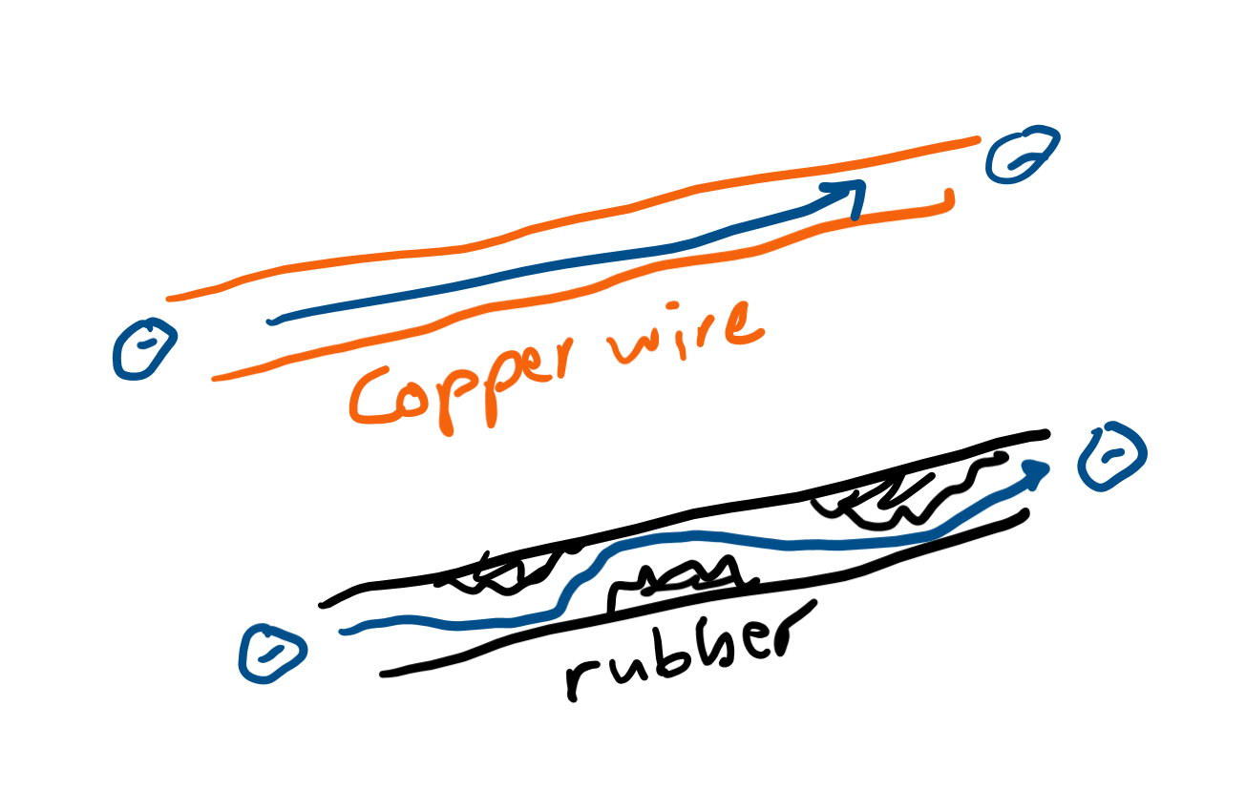
Which will electrons travel better through?
Just like the ball falls through different “mediums” faster, electrons travel through different “conductors” faster.
Which conductors do you think an electron can travel well through? (Things electrons can’t really travel through are called insulators, like rubber.)

Slide 19
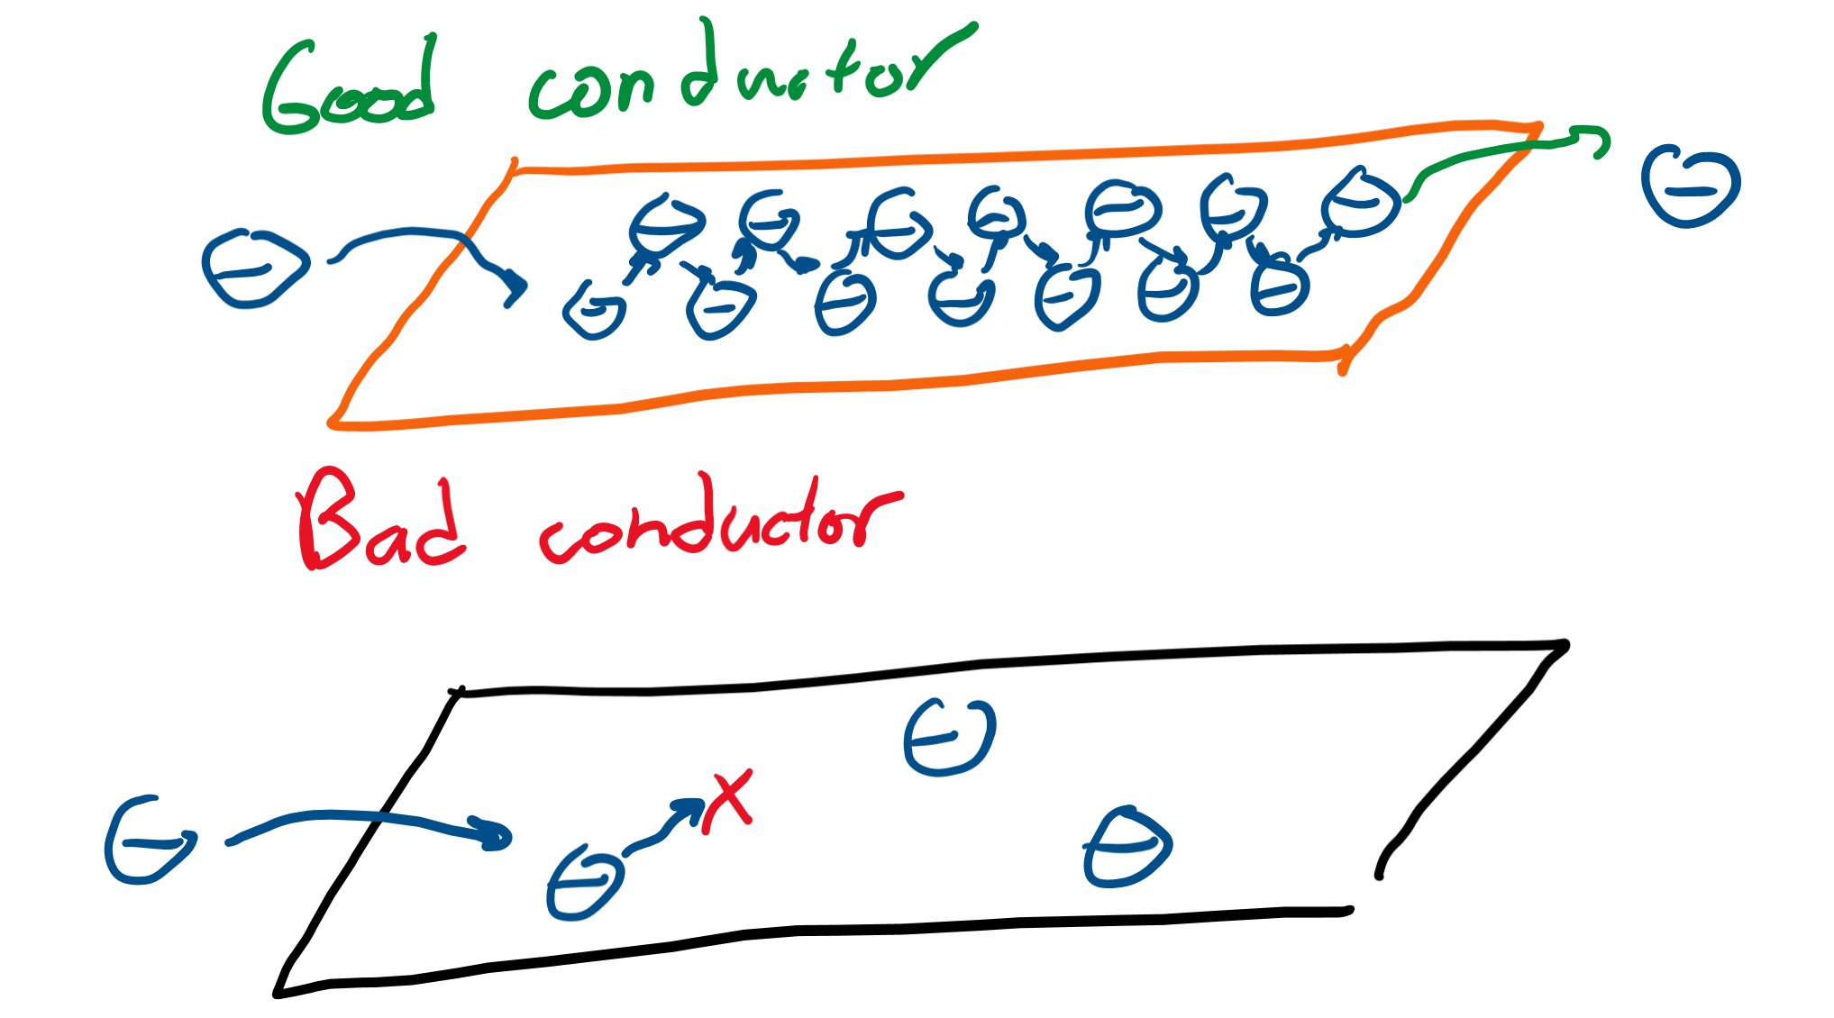
What conductors look like (gross it’s chemistry)
Good conductors are “seas” of electrons. This means that there’s a bunch of electrons in them, so one electron comes in, hits another and another and another until an electron pops out at the other end.

Slide 20
Review

Slide 21
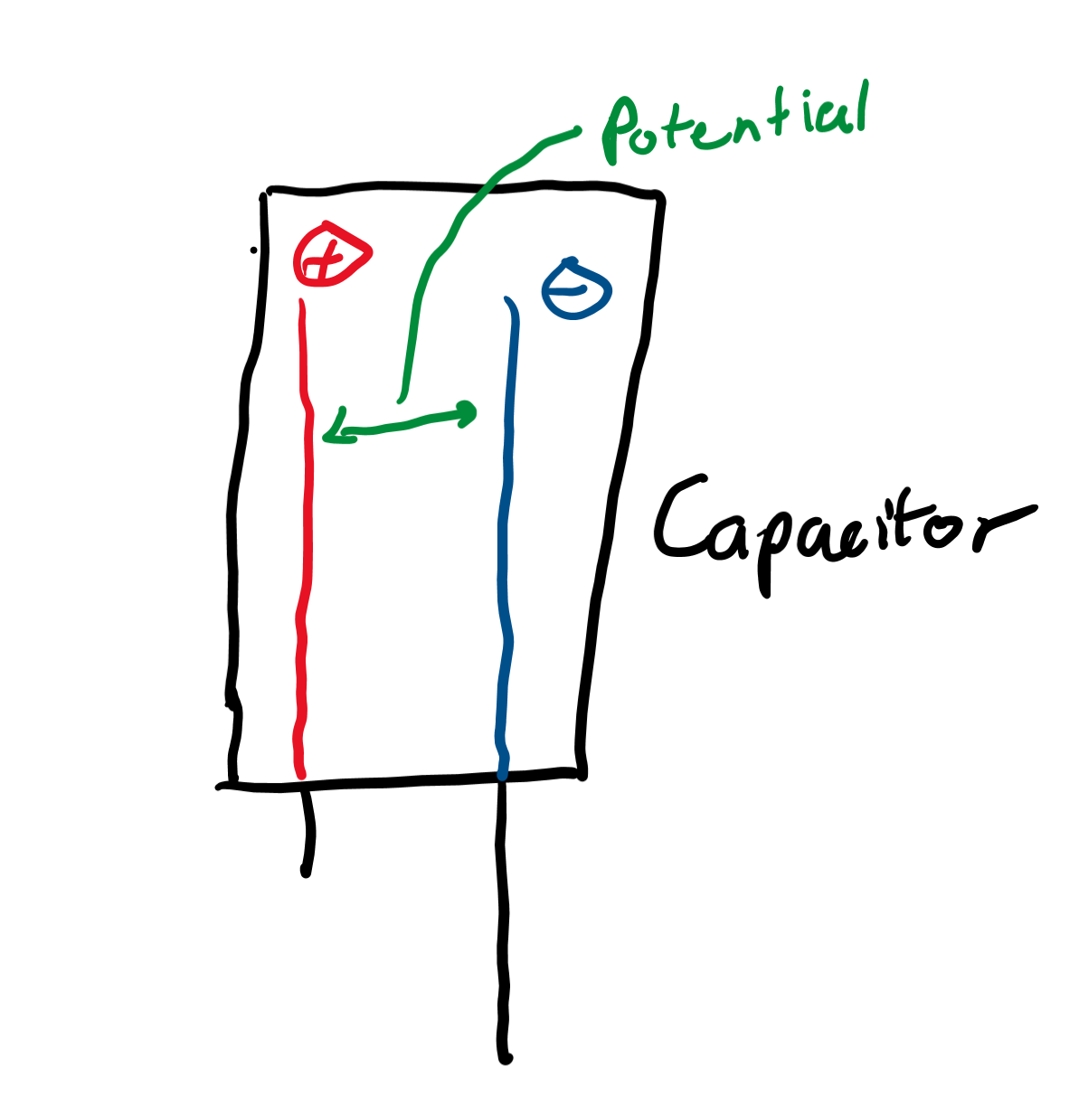
Storage of charge
Capacitors store “potential” for charge to move; so pretty much they store energy.

Slide 22
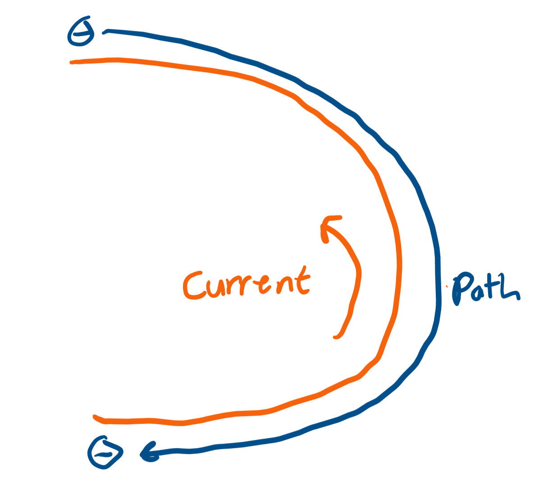
Path of a charge
Conductors are what electrons travel through. The motion of these electrons is “electricity.”

Slide 23
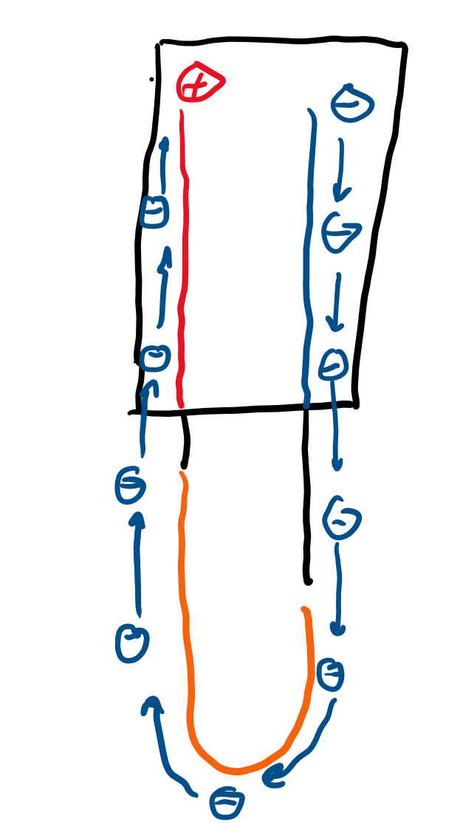
A “circuit”
If we combine a capacitor and a conductor, the capacitor “pushes” electrons through the conductor.
Wait! But that’s moving electrons, so we’ve produced electricity in a simple “circuit.”
The only problem is this circuit will catch on fire.

